Slide 1
Control Complexity in Bucklin, Fallback, and Plurality Voting: An Experimental Approach
Jörg Rothe & Lena Schend
SEA 2012, Bordeaux – June 2012
Heinrich-Heine-Universität Düsseldorf, Germany

Slide 2
Content
Introduction and Applications
Elections and Voting Systems
Electoral Control
Control Complexity – Theoretical Results
Experimental Setting
Experimental Results
Open Questions and Future Work

Slide 3
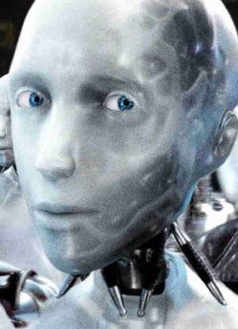
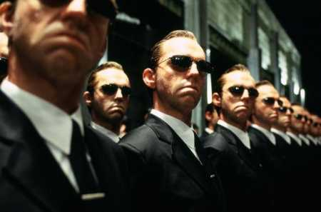
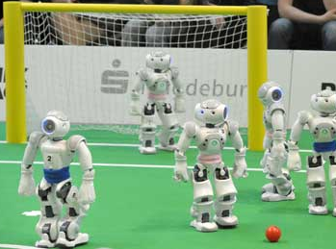
Social Choice Theory
voting theory
judgment aggregation
preference aggregation
multicriteria decision making
...
Computer Science
computational complexity theory
algorithm design
methods for the web
...
AI
apply voting systems
AI
MAS
ranking algorithms
meta search
...
Multiagent Systems

Slide 4
Social Choice Theory
voting theory
judgment aggregation
preference aggregation
multicriteria decision making
...
Computer Science
computational complexity theory
algorithm design
methods for the web
...
AI
analyze voting systems
computational barriers against tampering attempts
worst-/typical-case complexity
optimization algorithms
...
logic based analysis
...
Multiagent Systems

Slide 5
Social Choice Theory
voting theory
judgment aggregation
preference aggregation
multicriteria decision making
...
Computer Science
computational complexity theory
algorithm design
methods for the web
...
AI
analyze voting systems
computational barriers against tampering attempts
worst-/typical-case complexity
optimization algorithms
...
logic based analysis
...
Multiagent Systems

Slide 6
Social Choice Theory
voting theory
judgment aggregation
preference aggregation
multicriteria decision making
...
Computational Social
Choice
Computer Science
computational complexity theory
algorithm design
methods for the web
...
AI
analyze voting systems
computational barriers against tampering attempts
worst-/typical-case complexity
optimization algorithms
...
logic based analysis
...
Multiagent Systems

Slide 7
Elections and Voting Systems
An election is a pair (C,V) with
a finite set C of candidates
a finite list V of voters
Voters are represented by their preferences over C
either by linear orders:
> > >
or by approval vectors: (1,1,0,1)
Voting system: determines winners from the preferences

Slide 8
Elections and Voting Systems
Normalized Range Voting
SP-AV
Young
Veto
Smith
Plurality Voting
Maximin
Young
Schulze
Ranked Pairs
Copeland
Condorcet
STV
Plurality with runoff
k-Approval
Fallback Voting
Kemeny
Dodgson
Borda
Positional Scoring Rules
Approval Voting
Bucklin Voting
…

Slide 9
Elections and Voting Systems
Plurality Voting (PV)
v₁ > > >
v₂ > > >
v₃ > > >
v₄ > > >
Normalized Range Voting
SP-AV
Young
Veto
Smith
Plurality Voting
Maximin
Young
Schulze
Ranked Pairs
Copeland
Condorcet
STV
Plurality with runoff
k-Approval
2 | 2 | 0 | 0
Fallback Voting
Kemeny
Dodgson
Borda
Positional Scoring Rules
Approval Voting
Plurality winners:
Bucklin Voting
…

Slide 10
Elections and Voting Systems
Bucklin Voting (BV)
v₁ > > >
v₂ > > >
v₃ > > >
v₄ > > >
v₅ > > >
Normalized Range Voting
SP-AV
Young
Veto
Smith
Plurality Voting
Maximin
Young
Schulze
Ranked Pairs
Copeland
Condorcet
STV
Plurality with runoff
k-Approval
Lvl 1 | 2 | 2 | 1 | 0
Fallback Voting
Kemeny
Dodgson
Borda
Positional Scoring Rules
Approval Voting
Bucklin Voting
…
strict majority: 3 votes

Slide 11
Elections and Voting Systems
Bucklin Voting (BV)
v₁ > > >
v₂ > > >
v₃ > > >
v₄ > > >
v₅ > > >
Normalized Range Voting
SP-AV
Young
Veto
Smith
Plurality Voting
Maximin
Young
Schulze
Ranked Pairs
Copeland
Condorcet
STV
Plurality with runoff
k-Approval
Lvl 1 | 2 | 2 | 1 | 0
Lvl 2 | 2 | 3 | 2 | 3
Fallback Voting
Kemeny
Dodgson
Borda
Positional Scoring Rules
Approval Voting
Bucklin Voting
…
strict majority: 3 votes
Level 2 Bucklin winners:

Slide 12
Elections and Voting Systems
Fallback Voting (FV)
combines Bucklin and approval voting
Candidates:
v: { , } | { , }
v: > | { , }
Bucklin winners are fallback winners
If no Bucklin winner exists (due to disapprovals), then approval winners win.
Normalized Range Voting
SP-AV
Young
Veto
Smith
Plurality Voting
Maximin
Young
Schulze
Ranked Pairs
Copeland
Condorcet
STV
Plurality with runoff
k-Approval
Fallback Voting
Kemeny
Dodgson
Borda
Positional Scoring Rules
Approval Voting
Bucklin Voting
…

Slide 13
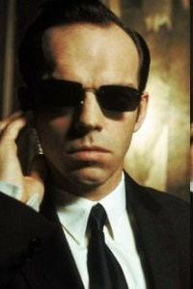
Electoral Control
v₁ > > >
v₂ > > >
v₃ > > >
v₄ > > >
via, e.g.:
Deleting Candidates
Plurality winner:
"chair":
knows all preferences
can change the structure of the election
2 | 1 | 1 | 0

Slide 14
Electoral Control
v₁ > > >
v₂ > > >
v₃ > > >
v₄ > > >
via, e.g.:
Deleting Candidates
Plurality winners:
"chair":
knows all preferences
can change the structure of the election
2 | 2 | 1 | 0

Slide 15
Electoral Control
v₁ > > >
v₂ > > >
v₃ > > >
v₄ > > >
v₅ > > >
via, e.g.:
Adding Voters
Plurality winners:
"chair":
knows all preferences
can change the structure of the election
2 | 1 | 2 | 0

Slide 16
Electoral Control
v₁ > > >
v₂ > > >
v₃ > > >
v₄ > > >
v₅ > > >
via:
Plurality winners:
"chair":
knows all preferences
can change the structure of the election
2 | 1 | 2 | 0
adding candidates/voters
deleting candidates/voters
partitioning candidates/voters

Slide 17
Control Complexity
Results due to Bartholdi, Tovey, Trick (MCM‘92),
Hemaspaandra, Hemaspaandra, Rothe (AI‘07),
Erdélyi, Rothe (CATS‘10), Erdélyi, Piras, Rothe (AAMAS‘11)

Slide 18
NP-hardness shields
NP-hardness shields are worst-case results!
Further research
average-case complexity
single-peaked electorates
approximation
experimental analysis
first suggested by Toby Walsh (IJCAI‘09,ECAI‘10) for manipulation in STV and veto
test (heuristic) algorithm on randomly generated or sampled elections
analyze frequency of manipulable elections

Slide 19
Experimental Setting
testing (heuristic) algorithm for control problem at hand on given elections
sample real elections
generate random elections
Impartial Culture (IC) model
Pólya-Eggenberger Urn model
Two Mainstreams (TM) model

Slide 20
Experimental Setting
testing (heuristic) algorithm for control problem at hand on given elections
sample real elections
generate random elections
Impartial Culture (IC) model
voters vote independently
all preferences are equally likely
Pólya-Eggenberger Urn model
Two Mainstreams (TM) model

Slide 21
Experimental Setting
testing (heuristic) algorithm for control problem at hand on given elections
sample real elections
generate random elections
Impartial Culture (IC) model
Pólya-Eggenberger Urn model
votes are highly correlated v₁ v₂ v₃ ...
Two Mainstreams (TM) model

Slide 22
Experimental Setting
testing (heuristic) algorithm for control problem at hand on given elections
sample real elections
generate random elections
Impartial Culture (IC) model
Pólya-Eggenberger Urn model
votes are highly correlated v₁ v₂ v₃ ...
Two Mainstreams (TM) model

Slide 23
Experimental Setting
testing (heuristic) algorithm for control problem at hand on given elections
sample real elections
generate random elections
Impartial Culture (IC) model
Pólya-Eggenberger Urn model
votes are highly correlated v₁ v₂ v₃ ...
Two Mainstreams (TM) model

Slide 24
Experimental Setting
testing (heuristic) algorithm for control problem at hand on given elections
sample real elections
generate random elections
Impartial Culture (IC) model
Pólya-Eggenberger Urn model
votes are highly correlated v₁ v₂ v₃ ...
Two Mainstreams (TM) model

Slide 25
Experimental Setting
testing (heuristic) algorithm for control problem at hand on given elections
sample real elections
generate random elections
Impartial Culture (IC) model
Pólya-Eggenberger Urn model
votes are highly correlated v₁ v₂ v₃ ...
Two Mainstreams (TM) model

Slide 26
Experimental Setting
testing (heuristic) algorithm for control problem at hand on given elections
sample real elections
generate random elections
Impartial Culture (IC) model
Pólya-Eggenberger Urn model
votes are highly correlated v₁ v₂ v₃ ...
Two Mainstreams (TM) model

Slide 27
Experimental Setting
testing (heuristic) algorithm for control problem at hand on given elections
sample real elections
generate random elections
Impartial Culture (IC) model
Pólya-Eggenberger Urn model
Two Mainstreams (TM) model

Slide 28
Experimental Setting
testing (heuristic) algorithm for control problem at hand on given elections
sample real elections
generate random elections
Impartial Culture (IC) model
Pólya-Eggenberger Urn model
Two Mainstreams (TM) model

Slide 29
Experimental Setting
testing (heuristic) algorithm for control problem at hand on given elections
sample real elections
generate random elections
Impartial Culture (IC) model
Pólya-Eggenberger Urn model
Two Mainstreams (TM) model v₁ v₂ v₃ v₄ ...

Slide 30
Experimental Setting
algorithms for all control types the 3 voting systems are resistant to
generated elections underlying the IC and TM model
up to 128 voters/candidates
500 elections for each data point
greedy algorithms checking promising control actions first (timeout implemented)

Slide 31
Experimental Results
TM model lower overall number of yes-instances
deleting/adding voters: increasing voters increases number of yes-instances
Constructive Control by Deleting Voters – fallback elections in
IC model

Slide 32
Experimental Results
TM model lower overall number of yes-instances
deleting/adding voters: increasing voters increases number of yes-instances
Constructive Control by Deleting Voters – fallback elections in
TM model

Slide 33
Experimental Results
destructive control more yes-instances than constructive control
destructive control nearly always possible ( IC model)
Constructive Control by Adding
Candidates – in plurality elections
in IC model
Destructive Control by Adding
Candidates – in plurality elections
in IC model

Slide 34
Experimental Results
FV and BV show similar tendencies
here: DCPV TP (NP-hardness for FV known, for BV not)
timeouts occur for similar election sizes
Destructive Control by Partition
of Voters – in fallback elections in
TM model
Destructive Control by Partition
of Voters – in Bucklin elections in
TM model

Slide 35
Experimental Results
General Observations:
destructive control shows more yes-instances (up to 100%) and lower computational costs
FV and BV show similar tendencies
voter control in PV has lower computational costs
deleting/adding voters show similar tendencies
for constructive control: voter control shows more yes-instances than candidate control
as expected: more yes-instances in the IC model than in the TM model

Slide 36
Open Questions and Future Work
open case for Bucklin voting (DCPV-TP)
improving the algorithms allowing
bigger election sizes
more candidates/voters to be added/deleted
higher number of elections per data point
to weaken time limit
...
other distribution models
other voting systems
...

Slide 37
Thank you very much!

